Slide 1
Predictive Analytics Current Advances & Its Popularity

Slide 2
Though predictive analytics has been around for decades, it's a technology whose time has come.
More and more organizations are turning to predictive analytics to increase their bottom line and competitive advantage. Why now?
Growing volumes and types of data, and more interest in using data to produce valuable insights.
Faster, cheaper computers.

Slide 3
Easier-to-use software.
Tougher economic conditions and a need for competitive differentiation.
With interactive and easy-to-use software becoming more prevalent, predictive analytics is no longer just the domain of mathematicians and statisticians.
Business analysts and line-of-business experts are using these technologies as well.

Slide 4
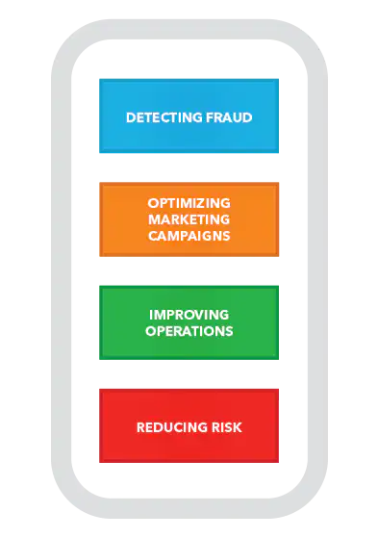
Why is predictive analytics important?

Slide 5
Organizations are turning to predictive analytics to help solve difficult problems and uncover new opportunities. Common uses include:
Detecting fraud. Combining multiple analytics methods can improve pattern detection and prevent criminal behavior.
As cybersecurity becomes a growing concern, high-performance behavioral analytics examines all actions on a network in real time to spot abnormalities that may indicate fraud, zero-day vulnerabilities and advanced persistent threats.

Slide 6
Optimizing Marketing Campaigns
Predictive analytics are used to determine customer responses or purchases, as well as promote cross-sell opportunities.
Predictive models help businesses attract, retain and grow their most profitable customers.

Slide 7
Improving operations
Many companies use predictive models to forecast inventory and manage resources.
Example: Airlines use predictive analytics to set ticket prices.
Hotels try to predict the number of guests for any given night to maximize occupancy and increase revenue.
Predictive analytics enables organizations to function more efficiently.

Slide 8
Reducing risk
Credit scores are used to assess a buyer’s likelihood of default for purchases and are a well-known example of predictive analytics.
A credit score is a number generated by a predictive model that incorporates all data relevant to a person’s creditworthiness.
Other risk-related uses include insurance claims and collections.

Slide 9
Any industry can use predictive analytics to reduce risks, optimize operations and increase revenue. Here are a few examples.

Slide 10
Banking & Financial Services
The financial industry, with huge amounts of data and money at stake, has long embraced predictive analytics to detect and reduce fraud, measure credit risk, maximize cross-sell/up-sell opportunities and retain valuable customers.
Commonwealth Bank uses analytics to predict the likelihood of fraud activity for any given transaction before it is authorized – within 40 milliseconds of the transaction initiation.

Slide 11
Oil, Gas & Utilities
Whether it is predicting equipment failures and future resource needs, mitigating safety and reliability risks, or improving overall performance, the energy industry has embraced predictive analytics with vigor.
Salt River Project is the second-largest public power utility in the US and one of Arizona's largest water suppliers.
Analyses of machine sensor data predicts when power-generating turbines need maintenance.

Slide 12
Health Insurance
In addition to detecting claims fraud, the health insurance industry is taking steps to identify patients most at risk of chronic disease and find what interventions are best.
Express Scripts, a large pharmacy benefits company, uses analytics to identify those not adhering to prescribed treatments, resulting in a savings of $1,500 to $9,000 per patient.

Slide 13
Retail
Since the now infamous study that showed men who buy milk often buy sugur at the same time, retailers everywhere are using predictive analytics for merchandise planning and price optimization, to analyze the effectiveness of promotional events and to determine which offers are most appropriate for consumers.
Staples gained customer insight by analyzing behavior, providing a complete picture of their customers, and realizing a 137 percent ROI.

Slide 14
Governments & the Public Sector
Governments have been key players in the advancement of computer technologies.
The US Census Bureau has been analyzing data to understand population trends for decades.
Governments now use predictive analytics like many other industries – to improve service and performance; detect and prevent fraud; and better understand consumer behavior.
They also use predictive analytics to enhance cybersecurity.

Slide 15
Manufacturing
For manufacturers it's very important to identify factors leading to reduced quality and production failures, as well as to optimize parts, service resources and distribution.
Lenovo is just one manufacturer that has used predictive analytics to better understand warranty claims – an initiative that led to a 10 to 15 percent reduction in warranty costs.

Slide 16
Thank You

